Slide 1

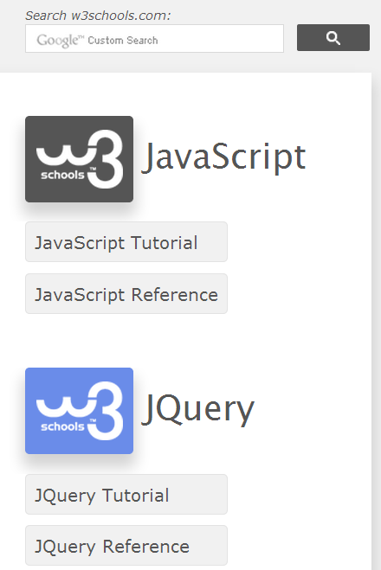


Slide 2
Weekly plan (HTML5, 1st semester 2017)
wk01 : Introduction to curriculum & current state of HTML5
wk02 : Making HTML5 documents
wk03 : Table, iframe and media
wk04 : Semantic tag and Form
wk05 : CSS3 I. Basic
wk06 : CSS3 II. Advanced
wk07 : CSS3 III. Animation
wk08 : Mid-term Exam.
wk09 : Javascript : Data types & operators
wk10 : Javascript : Loop & functions
wk11 : Javascript : Core objects
wk12 : Javascript : DOM
wk13 : Javascript : Event handling I
wk14 : Javascript : Event handling II
wk15 : Final exam.

Slide 3
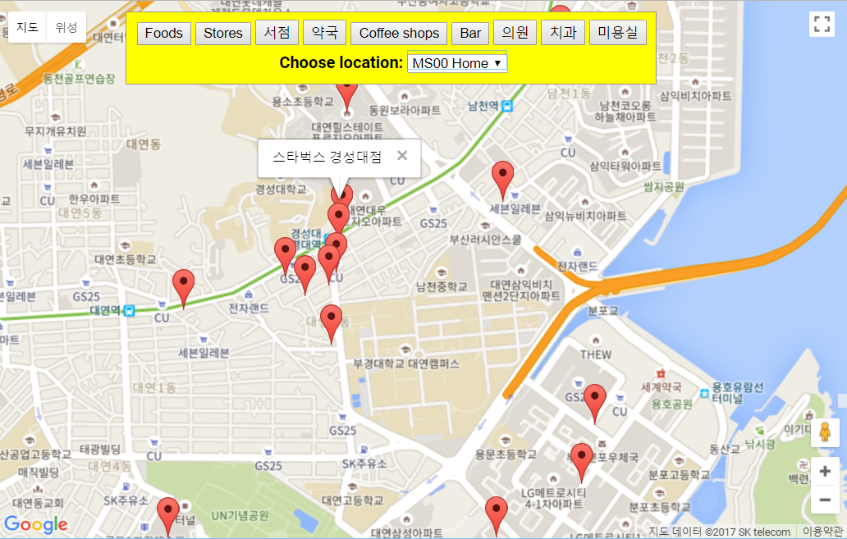
Weekly plan (Mobile Simulation,
2nd semester 2017)
wk01 : Introduction to curriculum & current state
wk02 : Browser Object Model (BOM), installing Brackets editor
wk03 : Canvas graphics I. Basic
wk04 : Canvas graphics II. Image & Transformation
wk05 : Canvas graphics III. Animation
wk06 : Canvas graphics IV. Game
wk07 : 보강 기간에 보강 실시
wk08 : Mid-term Exam.
wk09 : jQuery I. Basic
wk10 : jQuery II. Application
wk11 : SVG, Drag & Drop
wk12 : Google Map I: Intro
wk13 : Google Map II: Apps
wk14 : JS server - node.js
wk15 : Final exam.

Slide 4
과제09. msnn_rpt09.zip
[실습과제09] Google Map Basic
[1] 실습 결과 그림 3장 저장.
[2] MSnn_NPP_Alert .png
MSnn_Place_Markers.png
MSnn_MapType_UI.png
**** MSnn_Rpt09.zip 으로 압축해서 제출하시오.
[제출파일] msnn_rpt09.zip (11월14일 오후 6시 마감)
html 파일과 사용된 그림을 압축하여 이메일로 “msnn_rpt09” 제목으로 제출
Email : chaos21c@gmail.com

Slide 5
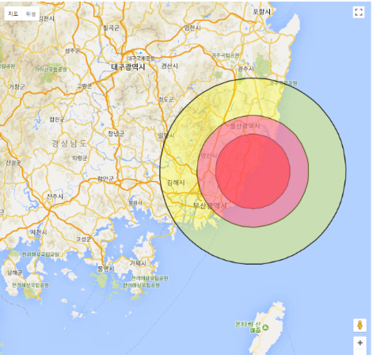
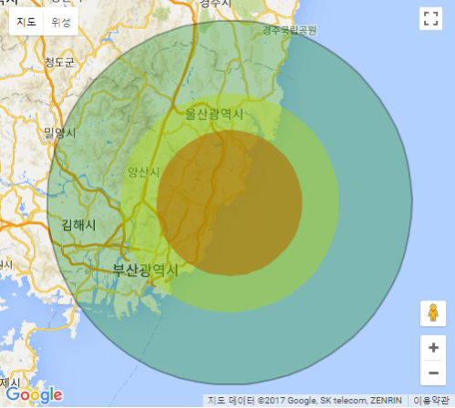
Result

Slide 6
CHAPTER 13
Google Map II. Apps
Develop apps using Google Map Api V3 & HTML5 Geolocation.
Before you start, you will need a free API key from Google (???).
API = Application programming interface.

Slide 7
Reference (w3schools.com) HTML5 Geolocation http://www.w3schools.com/html/html5_geolocation.asp Google Maps API Tutorial https://www.w3schools.com/graphics/google_maps_intro.asp Google Maps JavaScript API v3 (google.com) https://developers.google.com/maps/documentation/javascript/?hl=ko

Slide 8
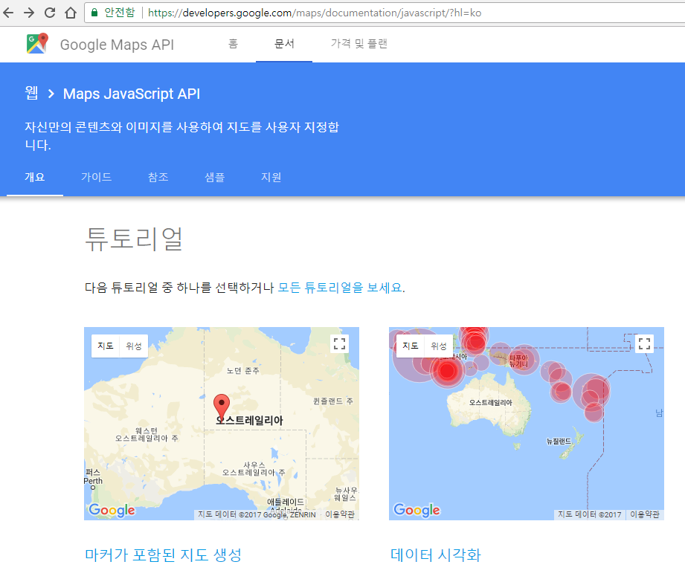
Reference (Google Maps JS API)

Slide 9
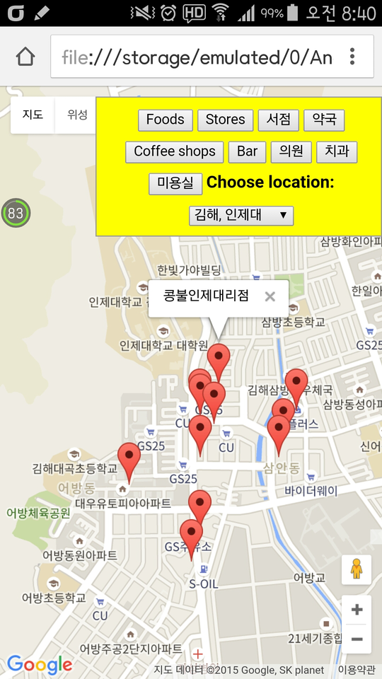
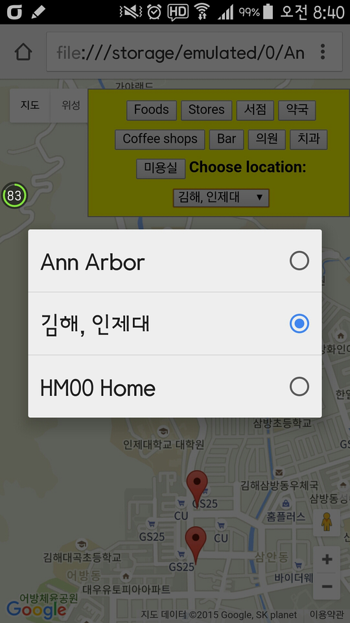
Target: Places

Slide 10
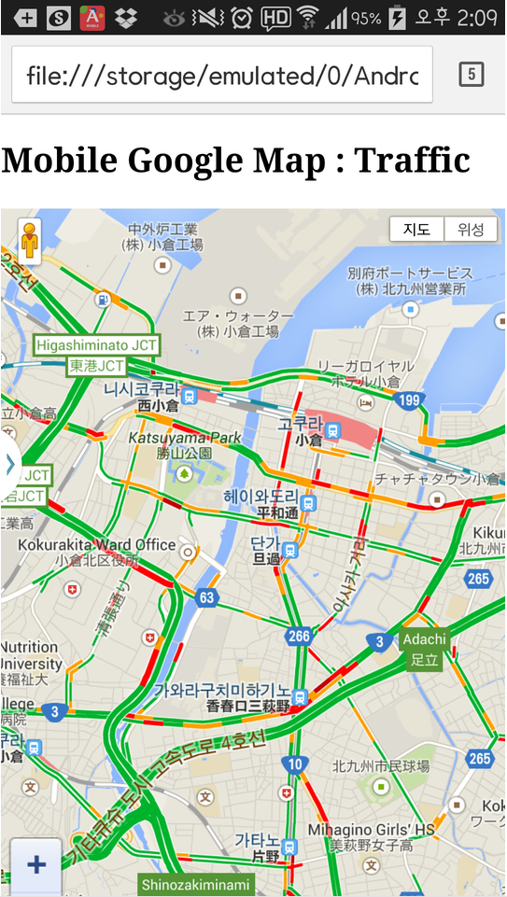
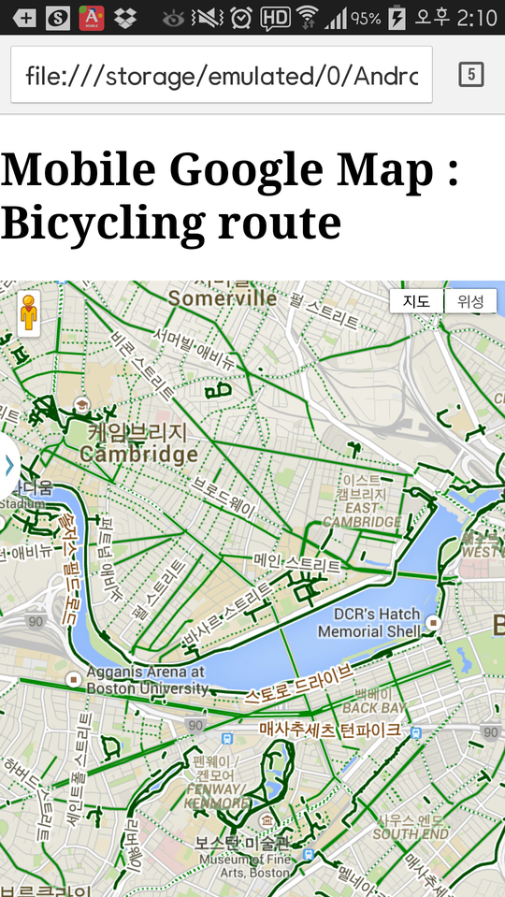
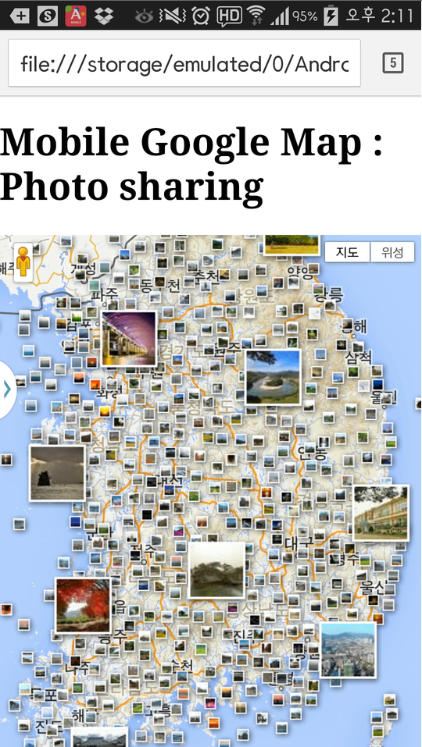

Target (N.A.): Using Google Map API V3

Slide 11
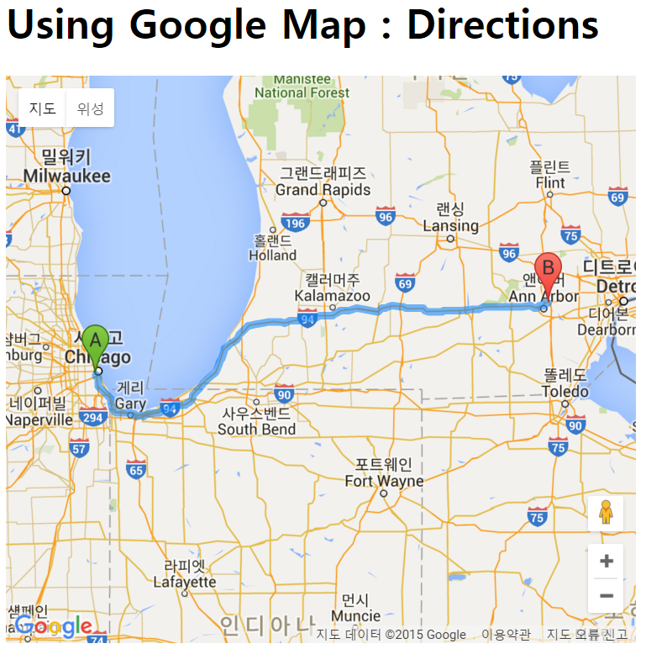
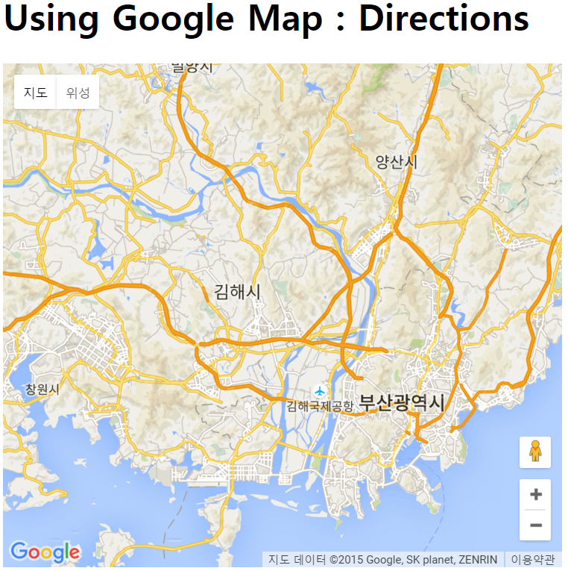
Target: Directions

Slide 12
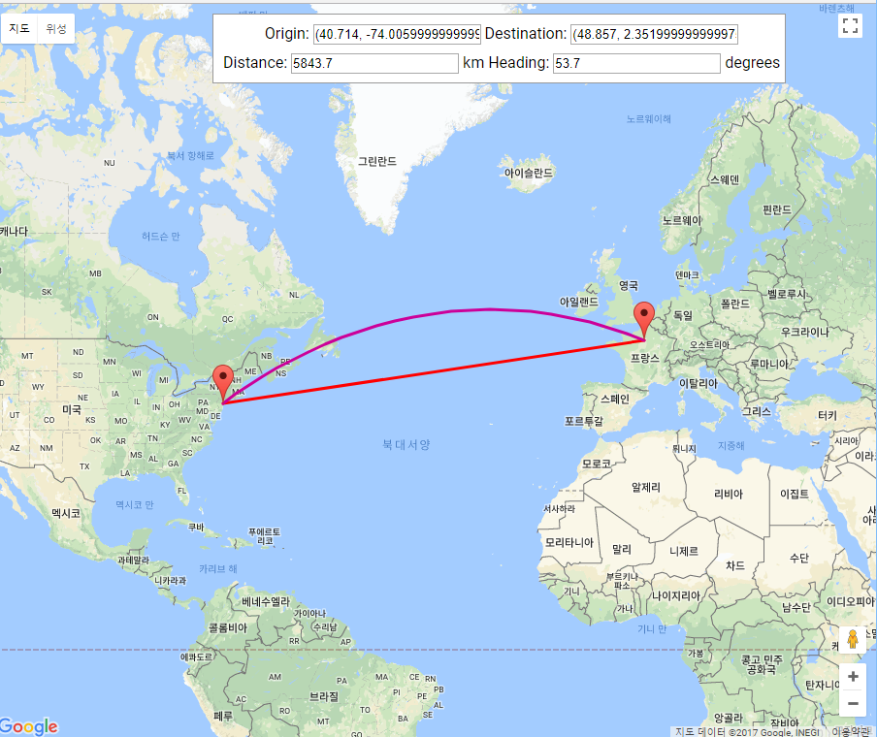
Target: Distance & heading

Slide 13
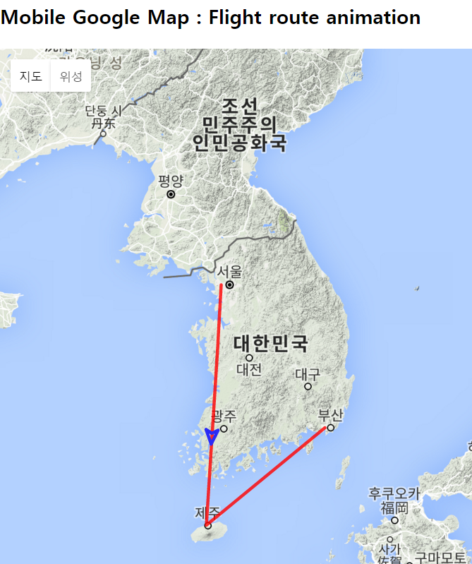
Challenge 1: Animation on Google map

Slide 14
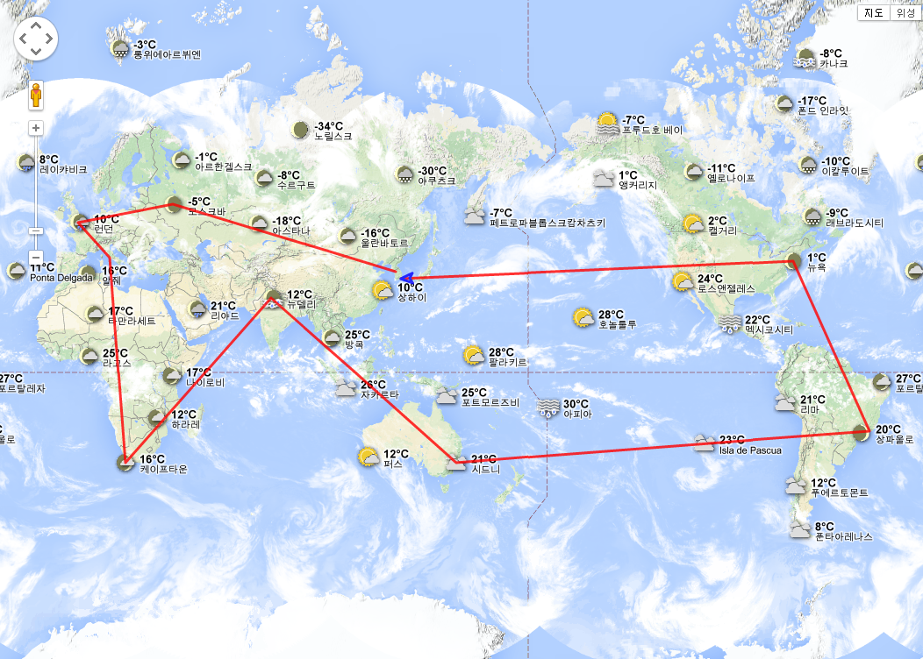
Challenge 2: World travel animation

Slide 15
Google Map Javascript API Advanced Mobile app, Animation, Direction, Places, Travel

Slide 16
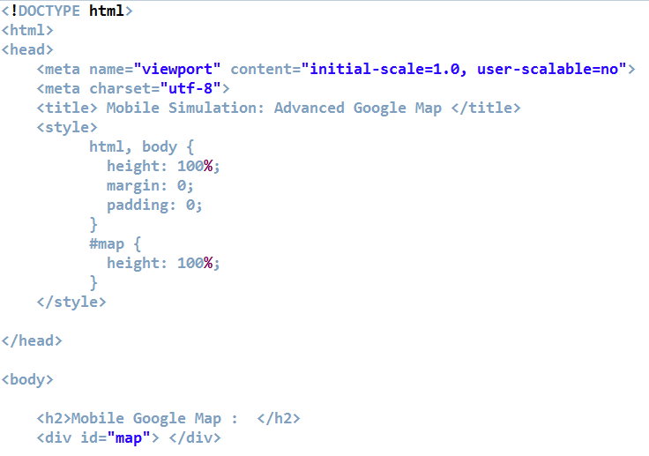
A1.1 Google Map for Mobile

Slide 17
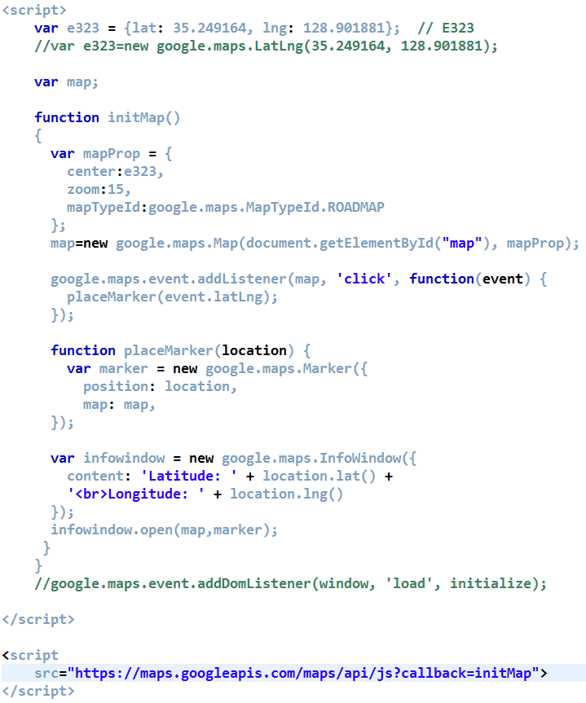
A1.2 Google Map for Mobile
Notes:
<script
src="https://maps.googleapis.com/maps/api/js?callback=initMap">
</script>

Slide 18
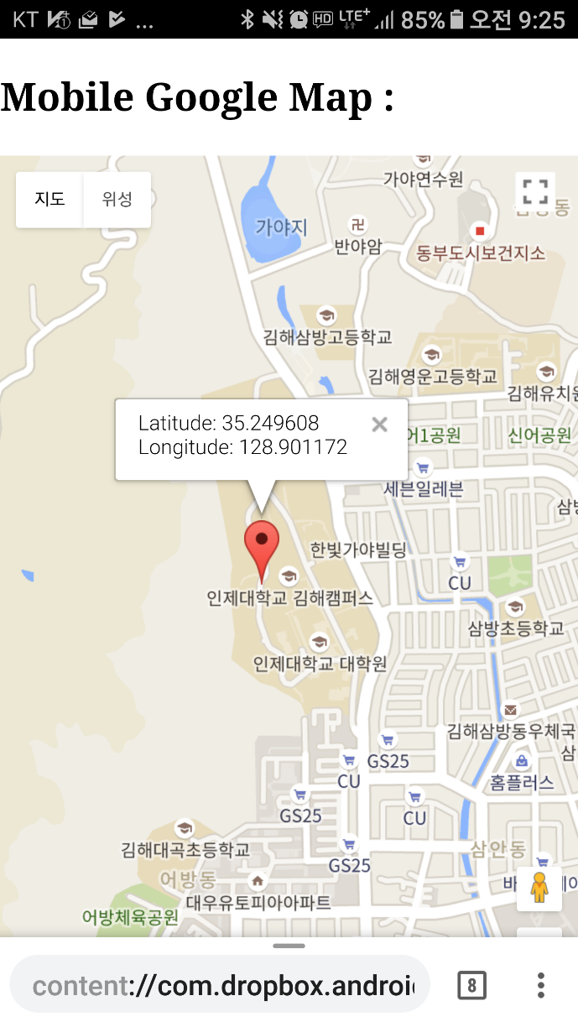
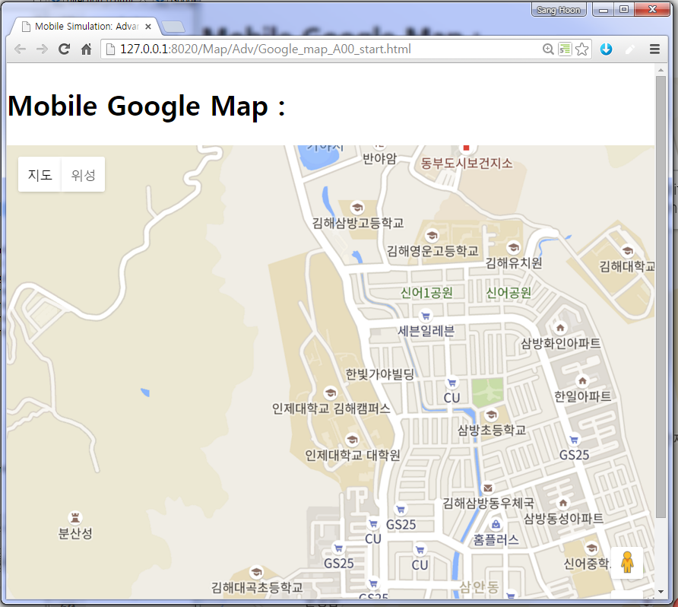
[Result] A1. Mobile setting
PC
Mobile

Slide 19
A2. Traffic
<script>
var e323 = {lat: 35.249164, lng: 128.901881}; // E323
var LA = {lat: 34.049245, lng: -118.241043};
function initMap()
{
var mapProp = {
center:LA, //e323,
zoom:10,
mapTypeId:google.maps.MapTypeId.ROADMAP
};
var map=new google.maps.Map(document.getElementById(“map"),mapProp);
var trafficLayer = new google.maps.TrafficLayer();
trafficLayer.setMap(map);
}
</script>

Slide 20
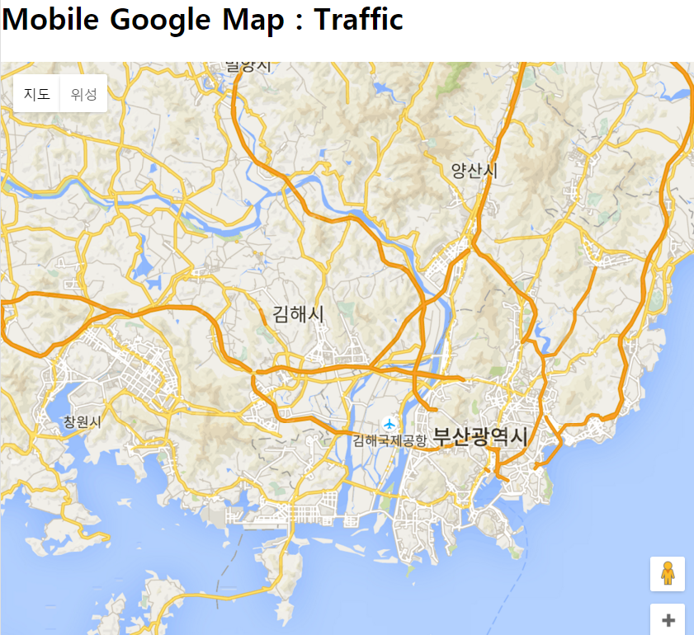
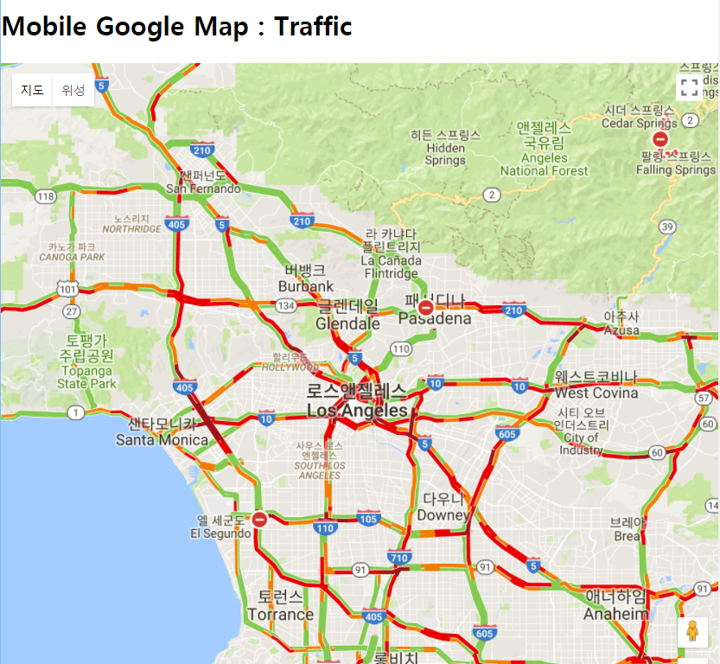
[Result] A2. Traffic

Slide 21
A3. Bicycling route
<script>
var e323 = {lat: 35.249164, lng: 128.901881}; // E323
var LA = {lat: 34.049245, lng: -118.241043};
function initMap()
{
var mapProp = {
center:LA, //e323,
zoom:10,
mapTypeId:google.maps.MapTypeId.ROADMAP
};
var map=new google.maps.Map(document.getElementById("googleMap"),mapProp);
var bykeLayer = new google.maps.BicyclingLayer();
bykeLayer.setMap(map);
}
</script>

Slide 22
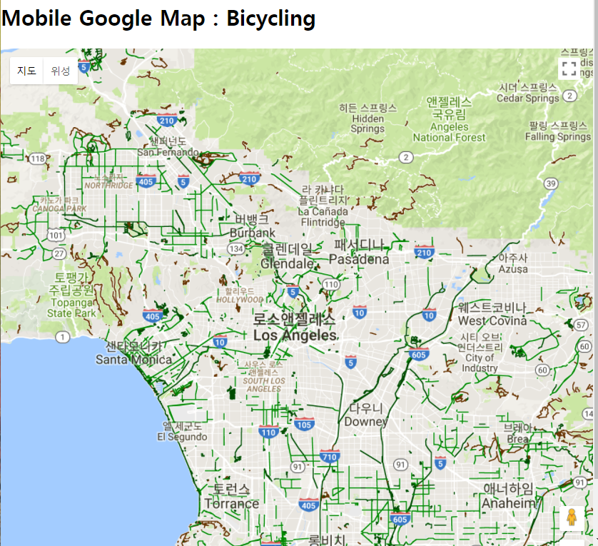
[Result] A3. Bicycling route

Slide 23
A4. Transit
<script>
var e323 = {lat: 35.249164, lng: 128.901881}; // E323
var LA = {lat: 34.049245, lng: -118.241043};
function initMap()
{
var mapProp = {
center:LA, //e323,
zoom:10,
mapTypeId:google.maps.MapTypeId.ROADMAP
};
var map=new google.maps.Map(document.getElementById("googleMap"),mapProp);
var aLayer = new google.maps.TransitLayer();
aLayer.setMap(map);
}
</script>

Slide 24
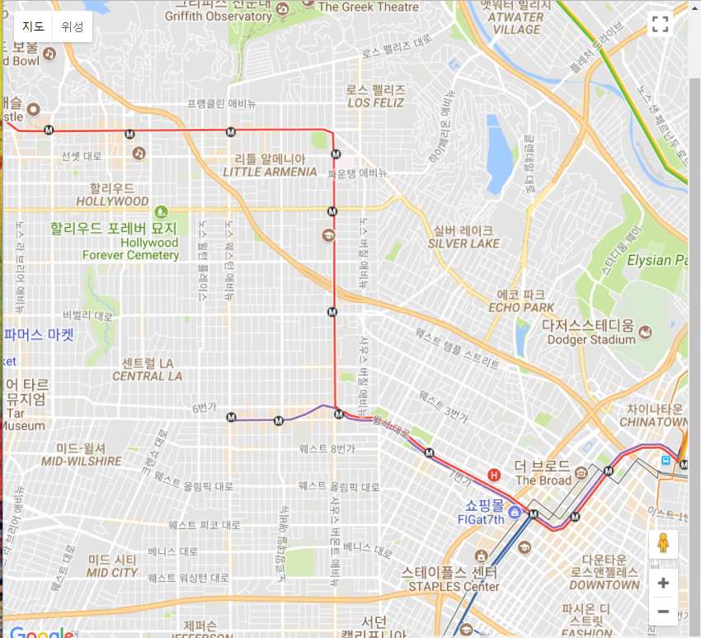
[Result] A4. Transit

Slide 25
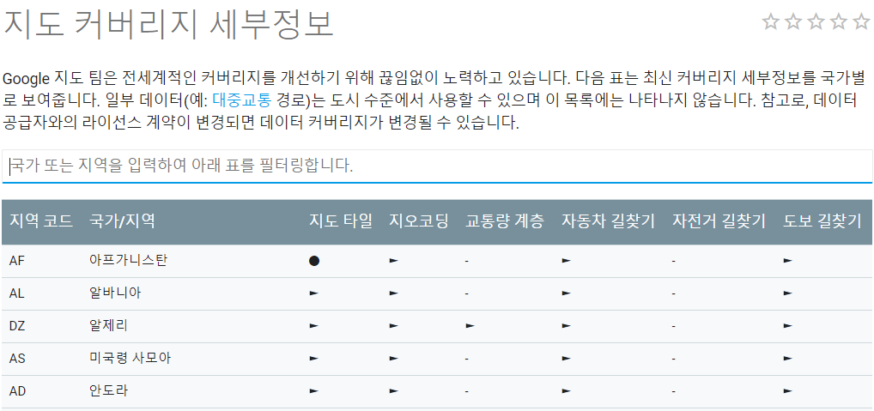
Google Map Coverage (ㅠㅠ)
https://developers.google.com/maps/coverage

Slide 26
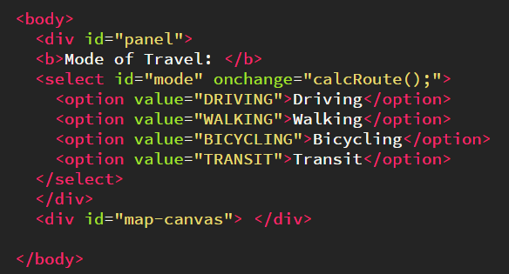
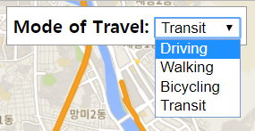
A5.0 All modes of travels

Slide 27
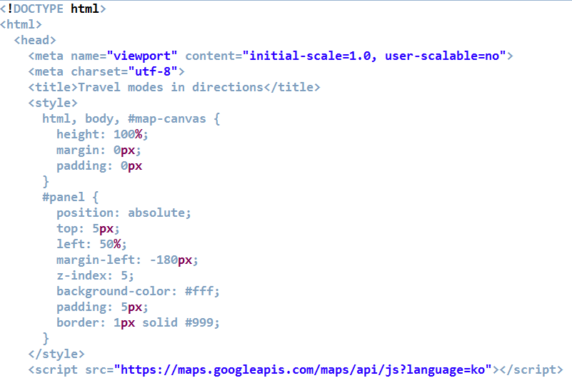
A5.1 All modes of travels

Slide 28
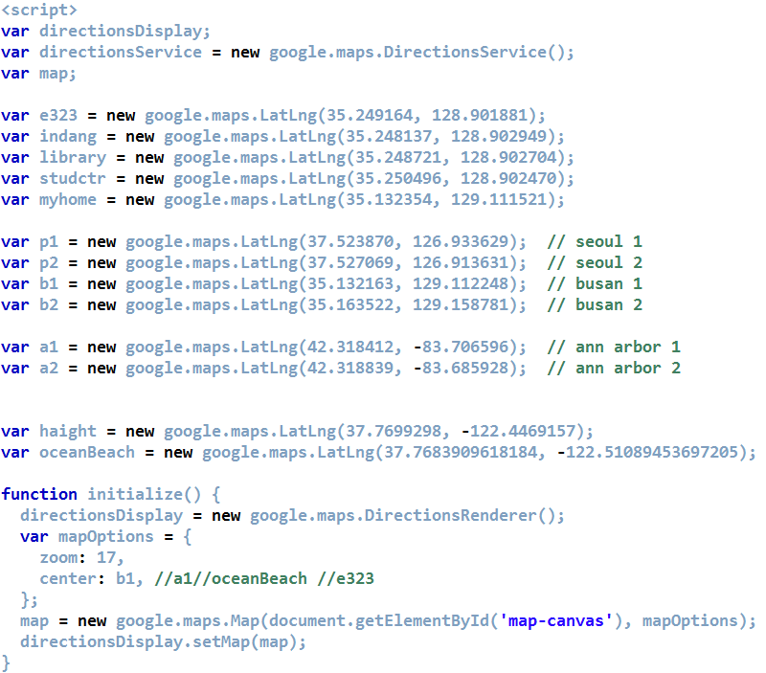
A5.2 All modes of travels

Slide 29
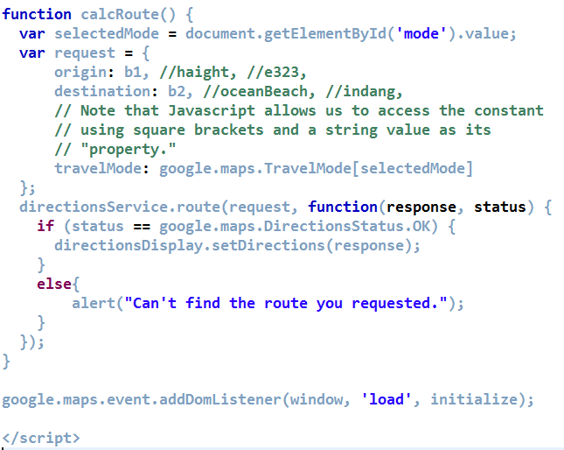
A5.3 All modes of travels

Slide 30
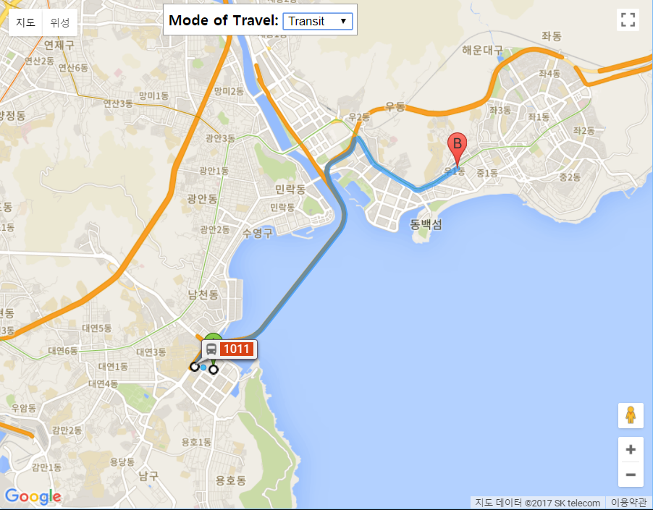
[Result] A5. All modes of travels
현재 가장 많이 이용하는
통학 구간을
구글지도에 표시하여
MSnn_Transit.png
로 저장
MSnn_Transit.png

Slide 31
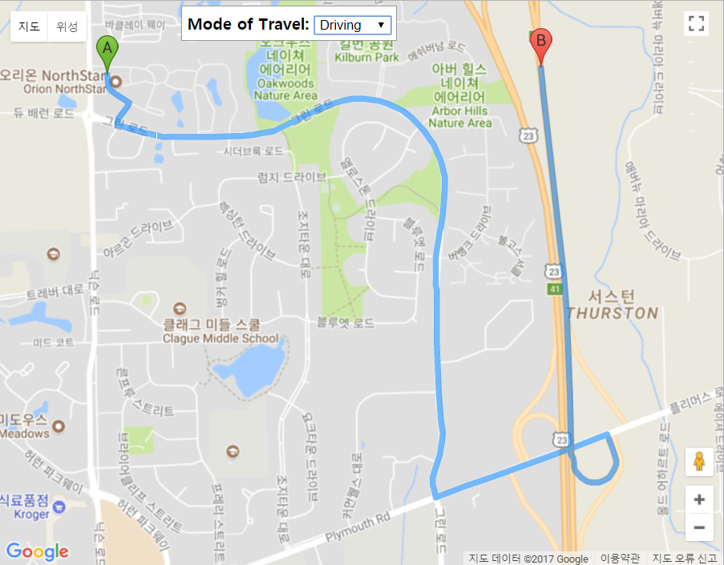
[Result] A5. All modes of travels

Slide 32
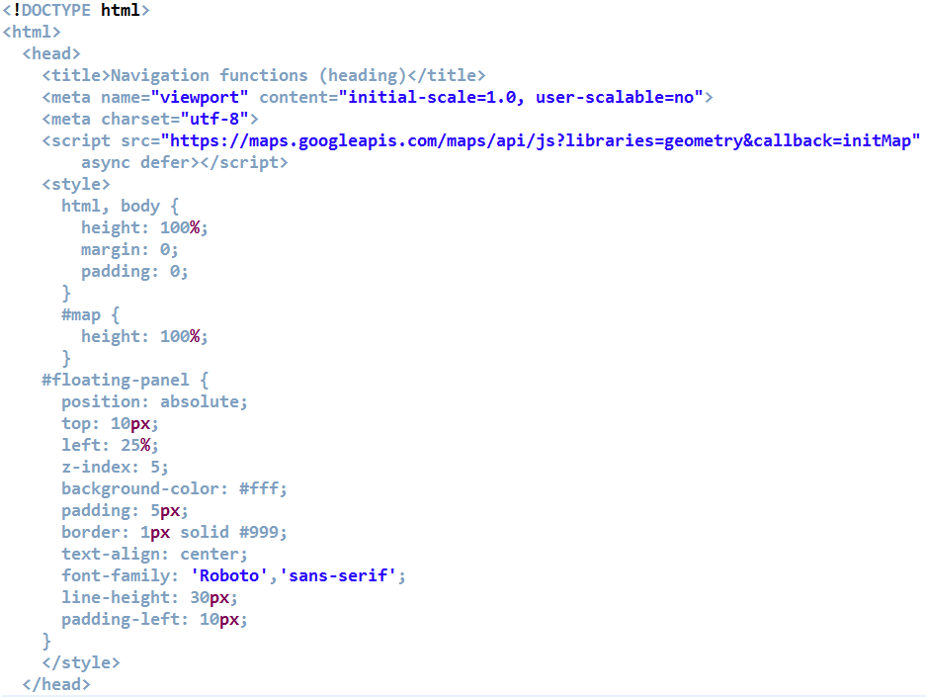
A6.1 Google map library: geometry

Slide 33
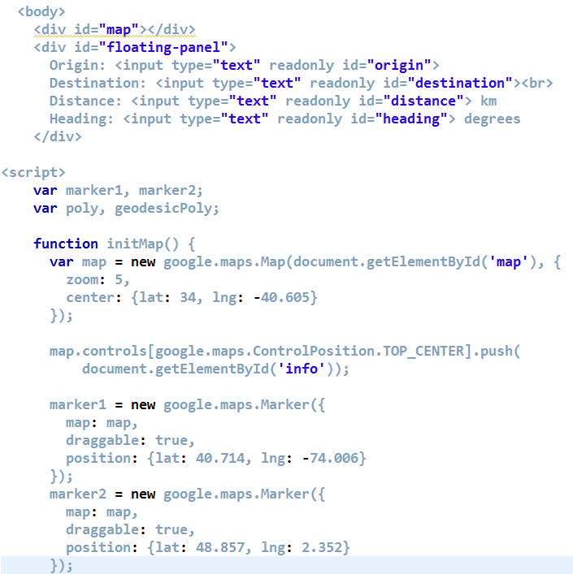
A6.2 Google map library: geometry

Slide 34
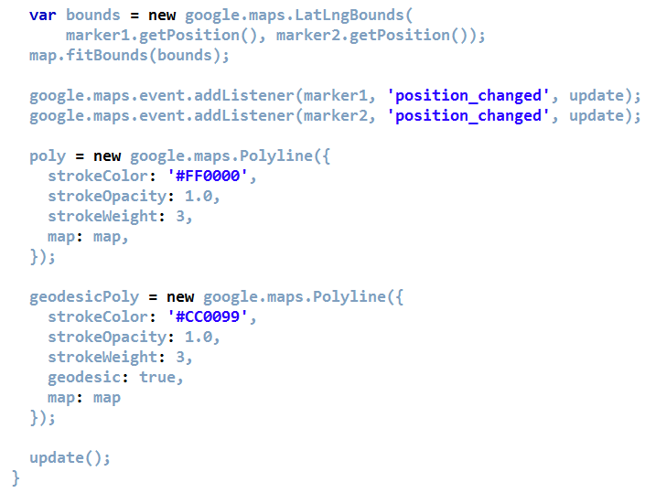
A6.3 Google map library: geometry

Slide 35
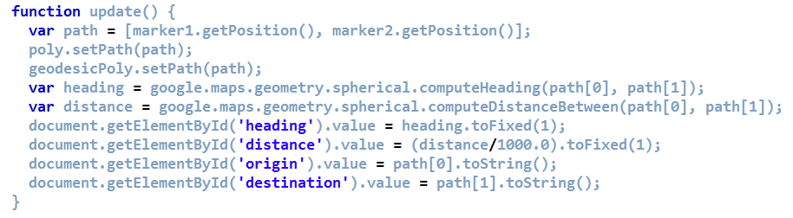
A6.4 Google map library: geometry

Slide 36
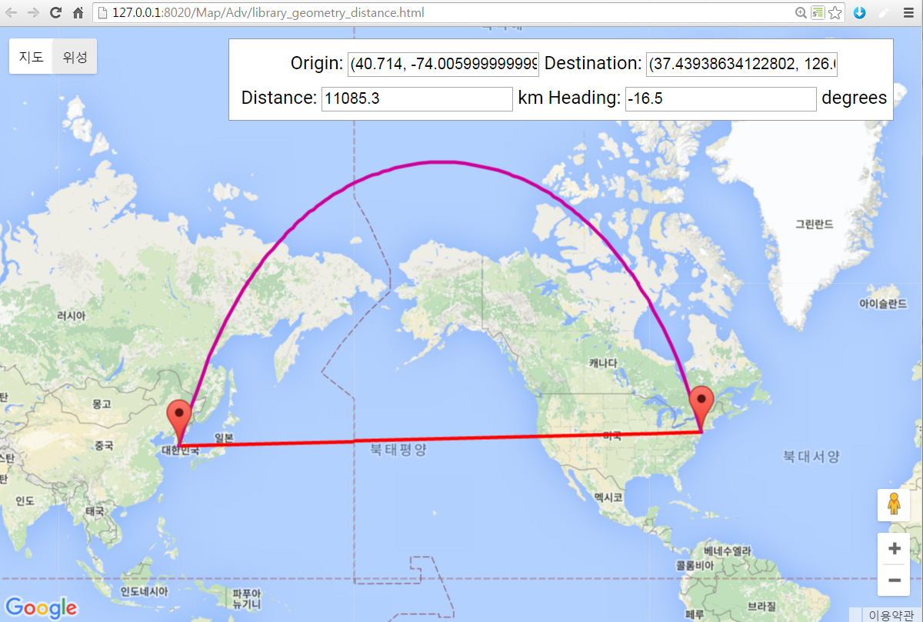
[Result] A6. library: geometry

Slide 37
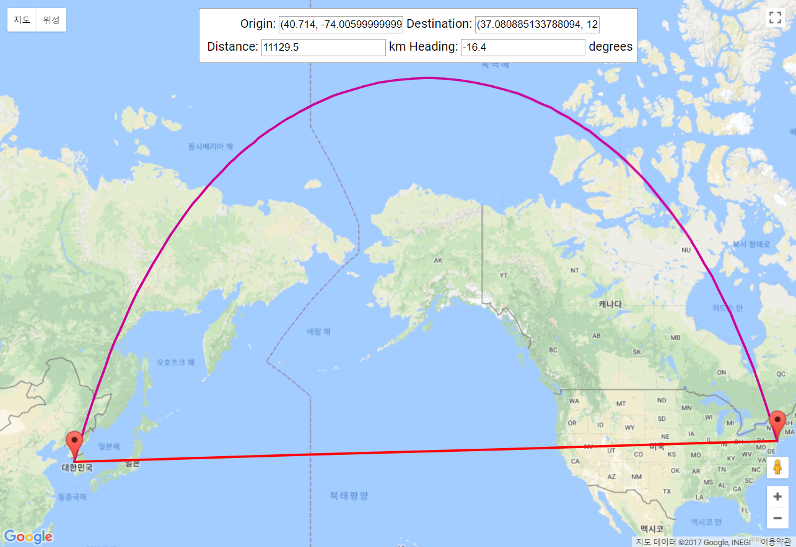
[Result] A6. library: geometry
MSnn_geometry.png

Slide 38
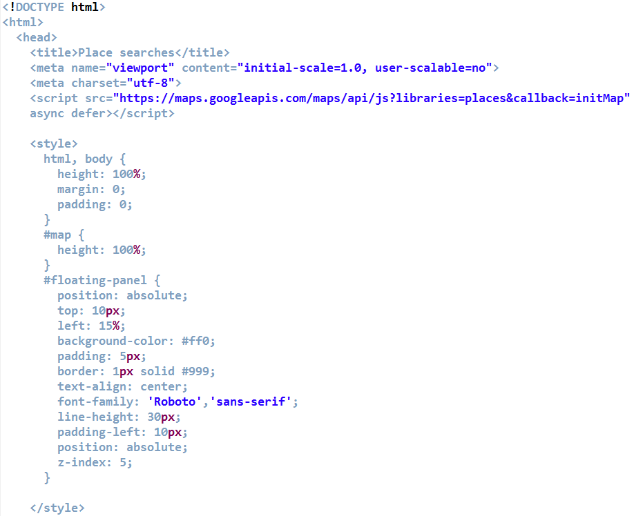
A7.1 Google map library: places

Slide 39
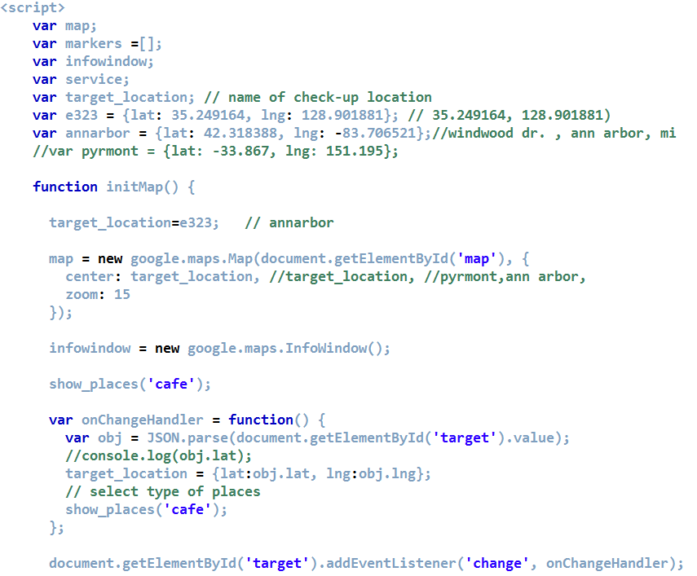
A7.2 Google map library: places

Slide 40
Types of places
accounting
airport
amusement_park
aquarium
art_gallery
atm
bakery
bank
bar
beauty_salon
bicycle_store
book_store
bowling_alley
bus_station
cafe
campground
car_dealer
car_rental
car_repair
car_wash
casino
cemetery
church
city_hall
clothing_store
convenience_store
courthouse
dentist
department_store
doctor
electrician
electronics_store
embassy
establishment
finance
fire_station
florist
food
funeral_home
furniture_store
gas_station
general_contractor
grocery_or_supermarket
gym
hair_care
hardware_store
health
hindu_temple
home_goods_store
hospital
insurance_agency
jewelry_store
laundry
lawyer
library
liquor_store
local_government_office
locksmith
lodging
meal_delivery
Notes:
https://developers.google.com/places/supported_types

Slide 41
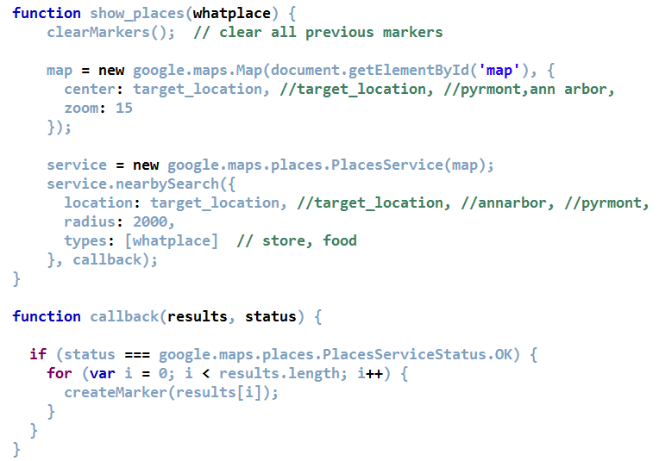
A7.3 Google map library: places

Slide 42
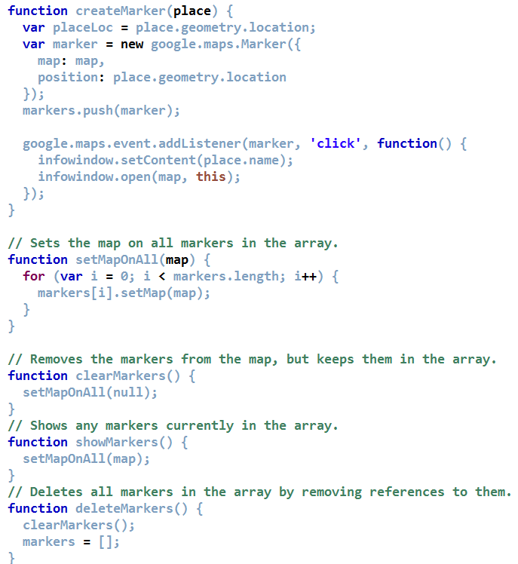
A7.4 Google map library: places

Slide 43
[Result] A7. Google map : places
집 주변 places 추가. MSnn_MyHome.png

Slide 44
A8. Weather with cloud
<script
src="http://maps.googleapis.com/maps/api/js?v=3.exp&language=ko
&sensor=false&libraries=weather">
</script>
<script>
var e323=new google.maps.LatLng(35.249164, 128.901881); // E323
function initialize()
{
var mapProp = {
center:e323,
zoom:7,
mapTypeId:google.maps.MapTypeId.ROADMAP
};
var map=new google.maps.Map(document.getElementById("googleMap"),mapProp);
var weatherLayer = new google.maps.weather.WeatherLayer ({
temperatureUnits:
google.maps.weather.TemperatureUnit.CELCIUS
});
weatherLayer.setMap(map);
var cloudLayer = new google.maps.weather.CloudLayer();
cloudLayer.setMap(map);

Slide 45
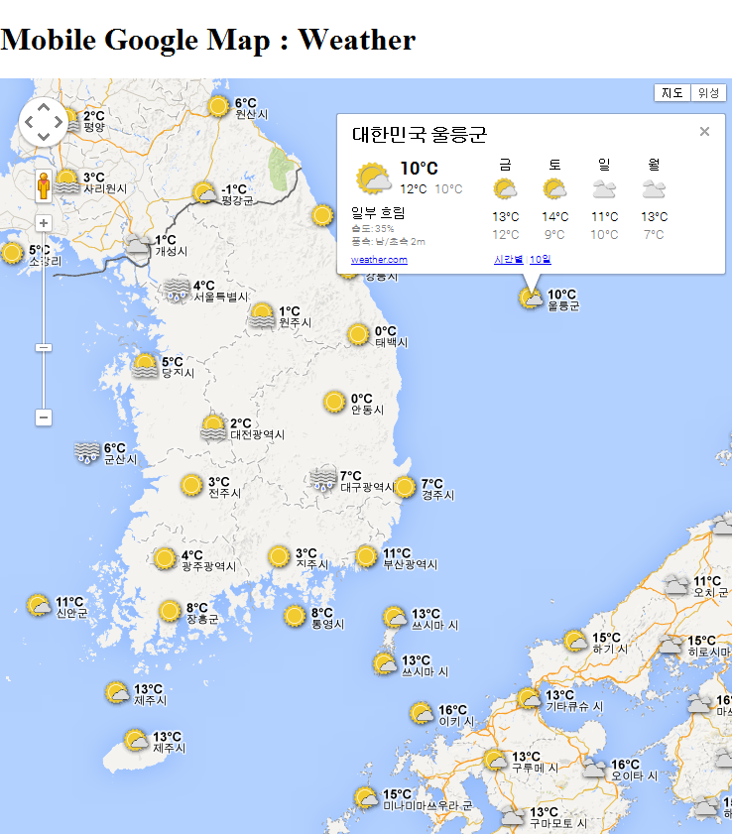
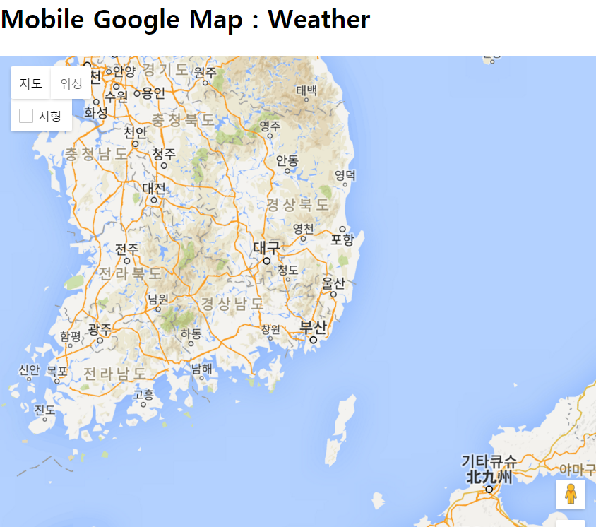
[Result] A8. Weather with cloud

Slide 46
A9. Photo sharing with Panoramio
<script
src="http://maps.googleapis.com/maps/api/js?v=3.exp&language=ko
&sensor=false&libraries=panoramio">
</script>
<script>
var e323=new google.maps.LatLng(35.249164, 128.901881); // E323
function initialize()
{
var mapProp = {
center:e323,
zoom:7,
mapTypeId:google.maps.MapTypeId.ROADMAP
};
var map=new google.maps.Map(document.getElementById("googleMap"),mapProp);
var panoramioLayer = new google.maps.panoramio.PanoramioLayer({
suppressInfoWindows:false
});
panoramioLayer.setMap(map);

Slide 47
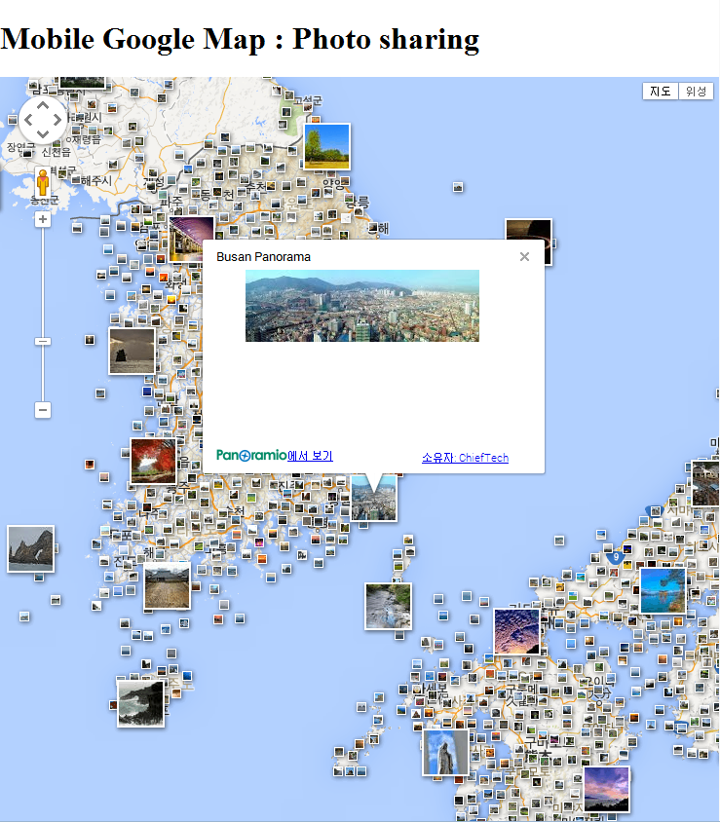
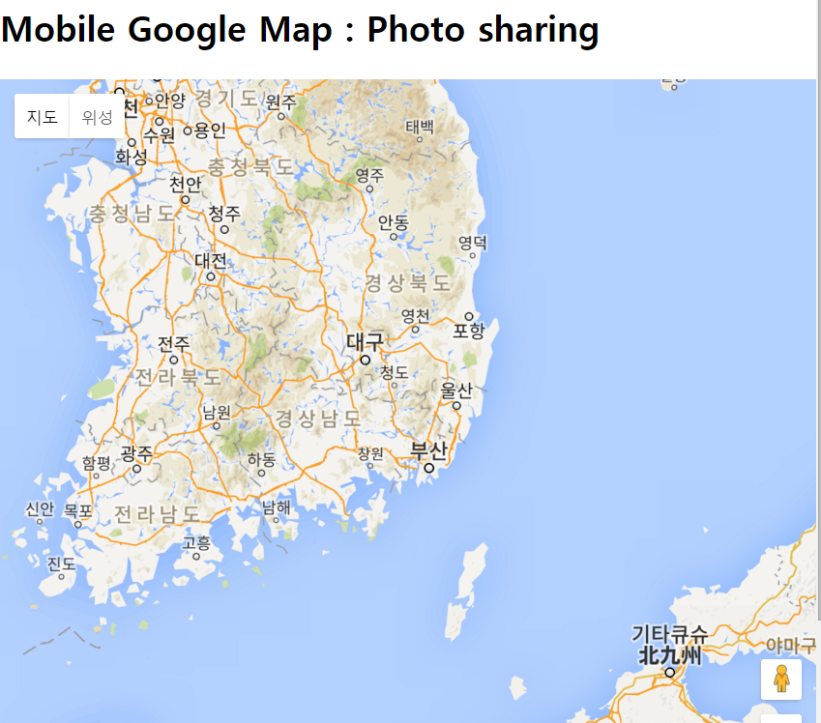
[Result] A9. Photo sharing with Panoramio

Slide 48
Google Map Javascript API Challenge stage

Slide 49
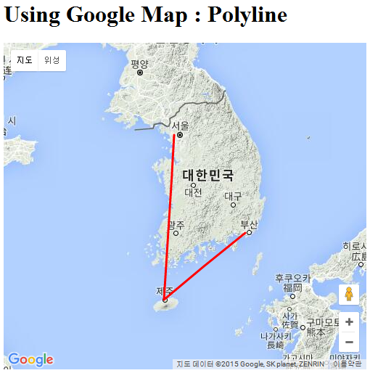
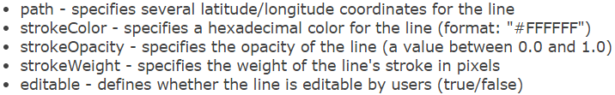
3.2.1 Add Polyline
function initMap() {
var mapProp = {
zoom: 6,
center: new google.maps.LatLng(35.840212, 127.125173), // 전주
mapTypeId: google.maps.MapTypeId.TERRAIN
};
var map = new google.maps.Map(document.getElementById('googleMap'),
mapProp);
// the path of Korean flight between Gimpo, Jeju, and Busan, Korea.
var flightPlanCoordinates = [
new google.maps.LatLng(37.558909, 126.803083), // Gimpo airport
new google.maps.LatLng(33.507758, 126.491434), // Jeju airport
new google.maps.LatLng(35.173431, 128.946659), // Gimhae airport
];
var flightPath = new google.maps.Polyline({
path: flightPlanCoordinates,
geodesic: true,
strokeColor: '#FF0000',
strokeOpacity: 1.0,
strokeWeight: 3
});
flightPath.setMap(map);
}

Slide 50
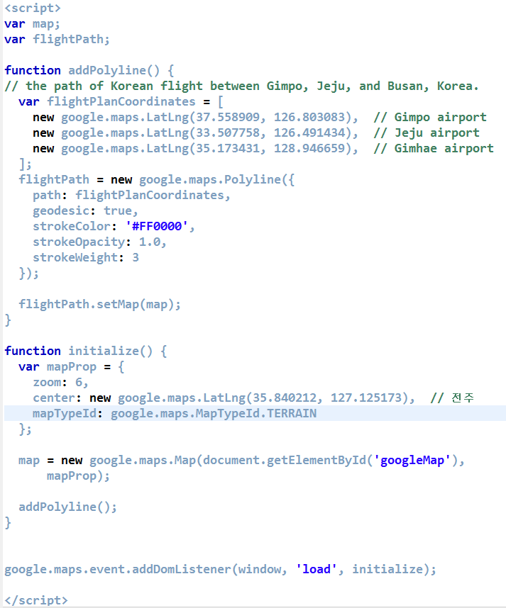
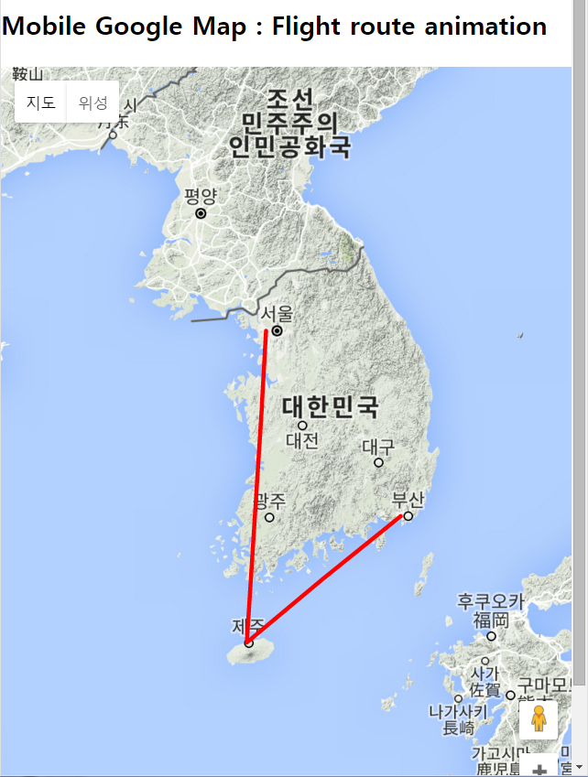
Challenge C1. Mobile version

Slide 51
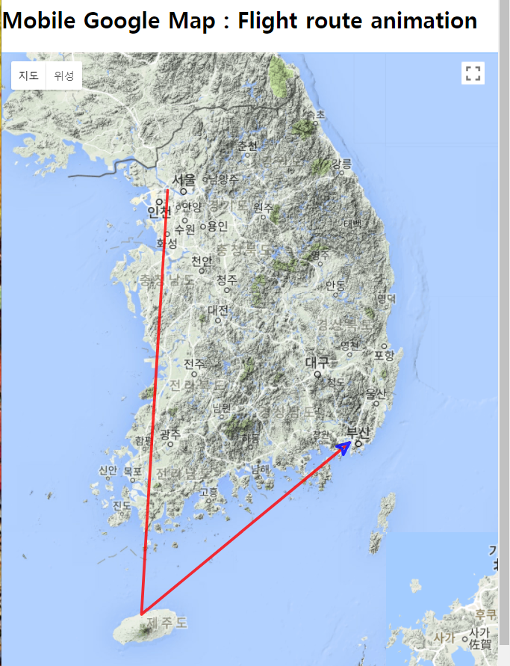
Challenge C2.1 Route animation
<script>
var map;
var flightPath;
// Defining arrow symbol
var arrowSymbol = {
strokeColor: '#00F',
scale: 3,
path: google.maps.SymbolPath.FORWARD_CLOSED_ARROW
};
function addAnimatedPolyline() {
// the path of Korean flight between Gimpo, Jeju, and Busan, Korea.
var flightPlanCoordinates = [
new google.maps.LatLng(37.558909, 126.803083), // Gimpo airport
new google.maps.LatLng(33.507758, 126.491434), // Jeju airport
new google.maps.LatLng(35.173431, 128.946659), // Gimhae airport
];
flightPath = new google.maps.Polyline({
path: flightPlanCoordinates,
//geodesic: true,
icons: [{
icon: arrowSymbol,
offset: '100%'
}],
strokeColor: '#FF0000',
strokeOpacity: 0.8,
strokeWeight: 3,
map: map
});
// Calling the arrow animation function
animateArrow();
}

Slide 52
Challenge C2.2 Route animation
function animateArrow() {
var counter = 0;
var intervalID=window.setInterval(function() {
counter = (counter + 1) % 200;
var arrows = flightPath.get('icons');
arrows[0].offset = (counter / 2) + '%';
flightPath.set('icons', arrows);
}, 50);
}
function initialize() {
var mapProp = {
zoom: 7,
center: new google.maps.LatLng(35.840212, 127.125173), // 전주
mapTypeId: google.maps.MapTypeId.TERRAIN
};
map = new google.maps.Map(document.getElementById('googleMap'),
mapProp);
addAnimatedPolyline();
}
Notes:
addAnimatedPolyline();

Slide 53

Challenge C3. Stop animation at home
function animateArrow() {
var counter = 0;
var intervalID=window.setInterval(function() {
counter = (counter + 1) % 200;
var arrows = flightPath.get('icons');
arrows[0].offset = (counter / 2) + '%';
flightPath.set('icons', arrows);
}, 50);
}
function animateArrow() {
var counter = 0;
var intervalID=window.setInterval(function() {
counter = (counter + 1) % 201;
var arrows = flightPath.get('icons');
arrows[0].offset = (counter / 2) + '%';
flightPath.set('icons', arrows);
if(counter==200){
clearInterval(intervalID);
}
}, 50);
}
MSnn_Flight_Stop.png

Slide 54

Challenge C4.1 Animation by distance (%)

Slide 55

Challenge C4.2 Animation by distance (%)

Slide 56

Challenge C4.3 Animation by distance (%)

Slide 57


Challenge C4.4 Animation by distance (%)

Slide 58

Challenge C4.5 Animation by distance (%)

Slide 59

도전과제
1. 아래 그림과 같이 세계 일주 여행 지도를 만드시오.
2. 꼭 가고 싶은 곳의 위치를 4 곳 이상 찾아서 추가하시오.
3. 구굴맵의 다양한 기능을 활용하시오. (아이콘, 애니메이션 변경)
html 파일을 MSnn_Google_Travel.html 로 저장하시오.

Slide 60

도전과제 – code#1

Slide 61

도전과제 – code#2

Slide 62

도전과제 – code#3

Slide 63

도전과제 – code#4

Slide 64

도전과제 – code#5

Slide 65
과제10. msnn_rpt10.zip
[실습과제10] Google Map apps
[1] 실습 결과 그림 4장 저장.
[2] MSnn_Transit.png, MSnn_geometry.png
MSnn_MyHome.png, MSnn_Flight_Stop.png
[3.1] 나의 세계 일주 여행 지도를 만드시오.
[3.2] 꼭 가고 싶은 곳의 위치를 4 곳 이상 찾아서 추가하시오.
[3.3] 구굴맵의 다양한 기능을 활용하시오. (아이콘, 애니메이션 변경)
html 파일을 MSnn_Google_Travel.html 로 저장하시오.
**** MSnn_Rpt10.zip 으로 압축해서 제출하시오.
[제출파일] msnn_rpt10.zip (11월21일 오후 6시 마감)
html 파일과 사용된 그림을 압축하여 이메일로 “msnn_rpt10” 제목으로 제출
Email : chaos21c@gmail.com

Slide 66

Result

Slide 67

API Key: Using Google Map API V3

Slide 68

교재 WEB 강의 소개
http://webprogramming.co.kr

Slide 69

관련 WEB 강의 소개 – w3schools.com
http://www.w3schools.com

